Slide 1


HEART DISEASE DIAGNOSTIC ANALYSIS
BY- AYUSH KUMAR SINGH

Slide 2

1
PROBLEM STATEMENT
2
3
4
5
Health is real wealth in the pandemic time we all realized the brute effects of covid-19 on all irrespective of any status. You are required to analyze this health and medical data for better future preparation.
6
7
8

Slide 3



1
INTRODUCTION
2
3
The COVID-19 pandemic served as a stark reminder that health is our most valuable asset. This presentation analyzes vast troves of health and medical data collected during this crisis. By leveraging this information, we can develop strategies to better prepare for future public health challenges.
4
5
6
7
8

Slide 4

1
DETAILS OF DATA
2
3
Age: Patient's age in years
Sex: Patient's biological sex (1 = male, 0 = female)
Chest Pain: Type of chest pain experienced (typical angina, atypical angina, non-anginal pain, asymptomatic)
Resting Blood Pressure: Blood pressure reading upon admission (in mmHg)
Cholesterol: Measured cholesterol level (in mg/dL)
Fasting Blood Sugar: Fasting blood sugar level (above 120 mg/dL or not)
Resting ECG: Results of resting electrocardiogram (normal, ST-T wave abnormality, left ventricular hypertrophy)
Maximum Heart Rate: Maximum heart rate achieved during exercise test
Exercise Angina (exang): (1 = Yes; 0 = No) Indicates presence of chest pain during exercise test.
ST Depression (oldpeak): Depth of ST segment depression on exercise ECG relative to resting ECG (in mm). A negative value indicates ST elevation.
ST Slope (slope): Represents the slope of the ST segment during peak exercise (1 = Upsloping, 2 = Flat, 3 = Downsloping).
Number of Major Vessels (ca): The number of major coronary arteries with a 70% or greater stenosis (narrowing) (0-3).
Thalassemia Status (thal): Severity of thalassemia, a blood disorder affecting hemoglobin (3 = Normal; 6 = Fixed Defect; 7 = Reversible Defect).
Myocardial Infarction (num): Presence of diagnosed heart disease (0 = No; 1 = Yes).
4
5
6
7
8

Slide 5

1
Main key performance indicator(Power BI)
2
3
Prevalence of Heart Disease Across Demographics
Age and Gender Breakdown of Heart Disease Population
Chest Pain Patterns in Heart Disease Patients
Cardiovascular Risk Factors: Blood Pressure, Cholesterol, Heart Rate
ST Depression Analysis: Age and Heart Disease Correlation
4
5
6
7
8

Slide 6
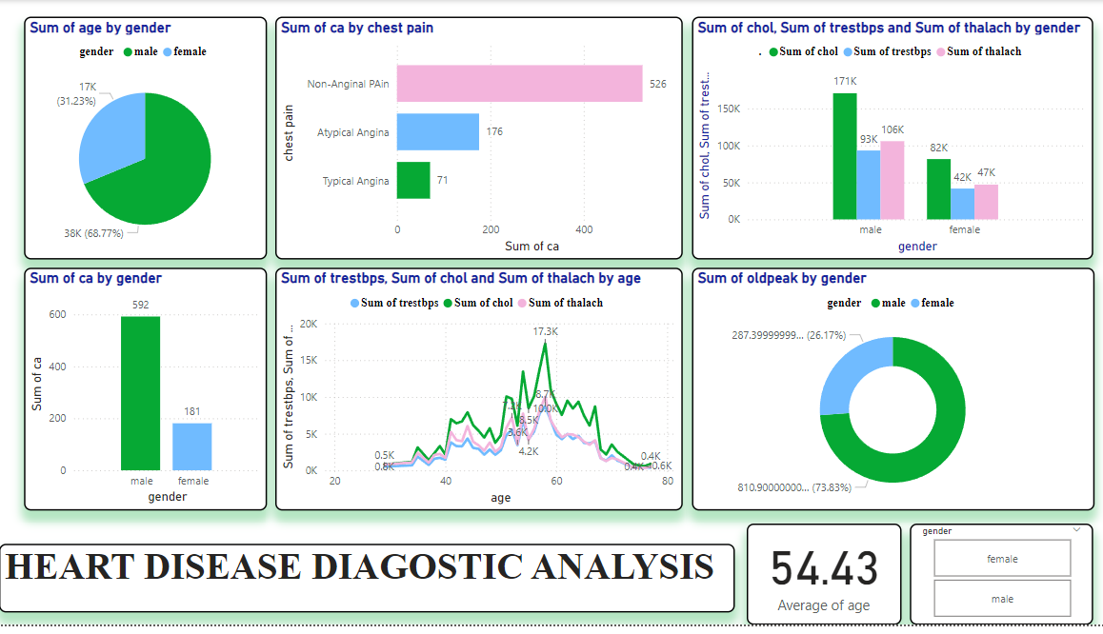
DASHBOARD ANALYSIS
1
2
3
4
5
6
7
8

Slide 7
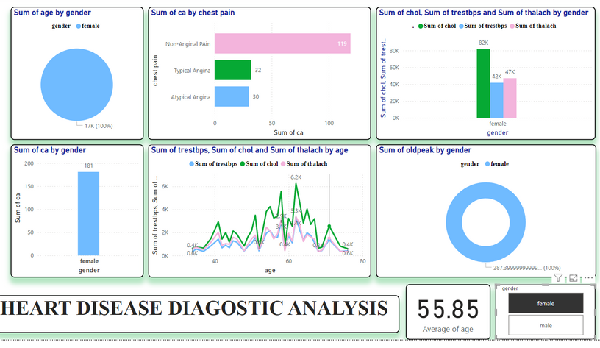
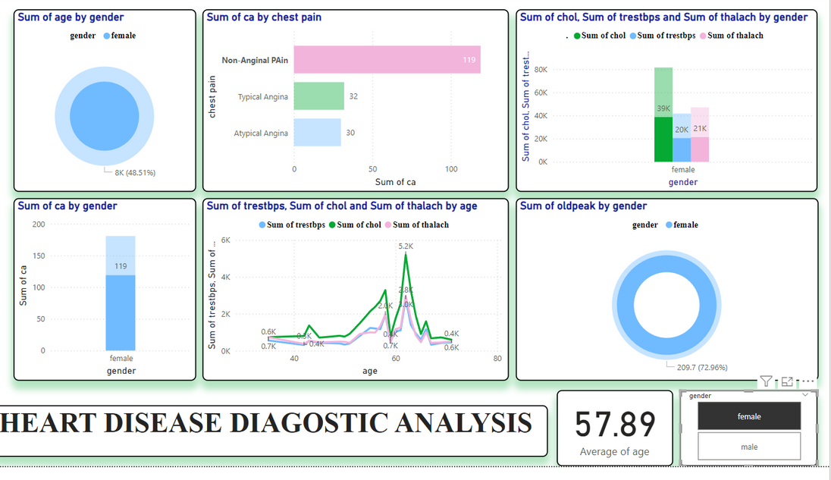
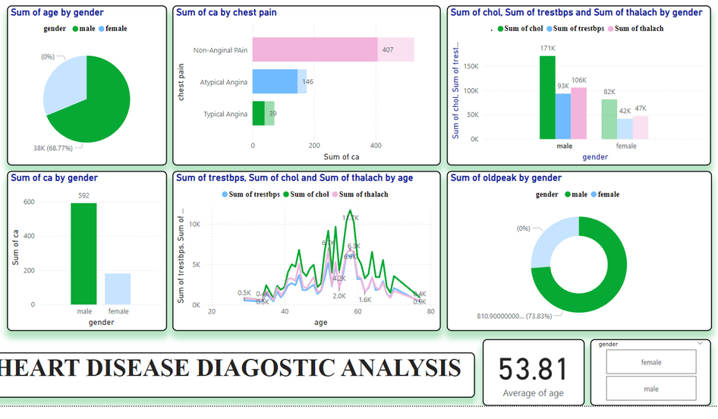
OTHER INSIGHTS
1
2
3
4
5
6
7
8

Slide 8

FEW OUTCOMES
1
2
There appears to be a higher percentage of females than males in the dataset (73.83% vs 26.17%).
People with chest pain tend to have higher cholesterol levels on average. This could be because chest pain is a symptom of coronary heart disease, which is caused by a buildup of plaque in the arteries.
There is a positive correlation between age and heart disease. This is because as people age, their arteries become more narrowed and hardened, which can lead to heart disease.
3
4
5
6
7
8

Slide 9

1
2
3
Thank you
4
5
6
7
8

